Slide 1

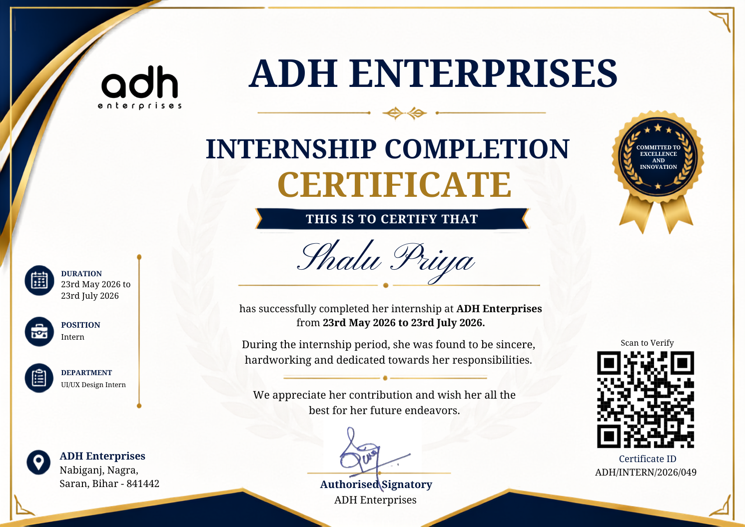

ADH ID
GENERATION SOFTWARE
Internship Presentation | Software Design and Development
Presented by:
Mohd Hunain Zafar
ADH Enterprises
2SSCS1003005431

Slide 2

INTERNSHIP OVERVIEW
• Product ideation and conceptualization for ADH ID Generation Software
• Software planning and defining overall system structure
• UI/layout contribution and interface design discussions
• Database management and data organization responsibilities

Slide 3

PROJECT OVERVIEW
A web-based ID Generation Software built to centralize and streamline the creation of structured ID cards — enabling organized, consistent identity management for organizations of all sizes.
The system establishes a structured workflow for managing student, employee, and parent records through a unified interface — reducing repetitive manual effort and ensuring consistent ID layouts across all outputs.
By organizing information logically and automating document generation, the platform minimizes errors, enforces layout consistency, and provides a scalable foundation for institutional identity management at ADH Enterprises.

Slide 4

PROBLEM & PROJECT OBJECTIVES
• Managing large volumes of student, employee and parent records manually
• Inconsistent ID card layouts and formatting across record types
• Frequent corrections due to data entry errors and lack of validation
• Organize and automate ID generation with a structured digital workflow
• Provide a clear, intuitive interface for managing all record types
• Enable logical data organization and future extensibility of the system
These challenges highlighted the need for a reliable, scalable solution. The project objectives were defined to address manual inefficiencies, ensure consistency across ID records, and build a system that supports long-term growth at ADH Enterprises.

Slide 5

MY CONTRIBUTION
• Contributed to product ideation and early concept development
• Participated in planning and defining the overall product structure
• Involved in front-end contribution and layout/workflow discussions
• Managed database structure and supported data organization efforts

Slide 6
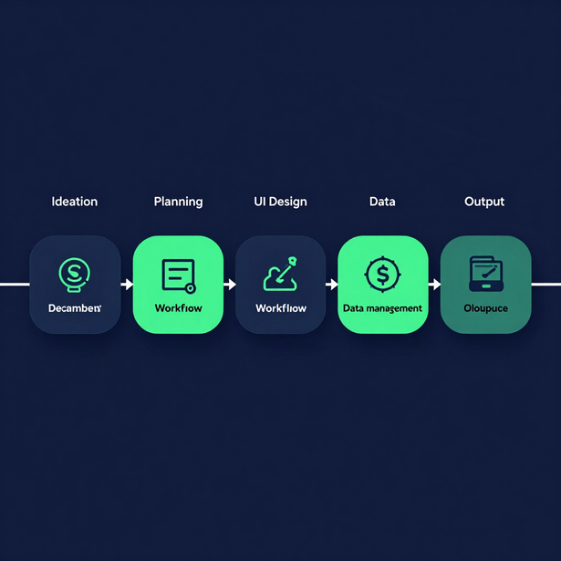
SYSTEM STRUCTURE
Product Idea → Planning & Structure → Layout & UI: Hunain contributed from the earliest stages — initiating the product concept, shaping the planning and structural foundation, and participating in layout and user interface discussions to define how the system would look and function.
User Workflow → Data Management: Hunain helped define the logical user workflow — how operators would navigate the system — and contributed to database management, ensuring information was organized, accessible and structured for reliable ID record handling.
ID Generation & End-to-End Contribution: Across all six stages of the product lifecycle, Hunain served as an active contributor — bridging ideation, structure, interface, workflow and data into a cohesive ID generation system at ADH Enterprises.

Slide 7

DEVELOPMENT METHODOLOGY
The development process began with Product Ideation, where the core concept for the ID Generation Software was defined, followed by Planning and Product Structure to establish a clear roadmap, module breakdown, and system architecture for ADH Enterprises.
Layout and Workflow design translated the planned structure into a coherent user interface and logical process flow, ensuring each step of ID generation was intuitive. Front-End Contribution then brought these designs to life using React component-driven architecture.
Database Management formed the final pillar of the methodology, integrating PostgreSQL to handle structured data storage, CRUD operations, and reliable record management — completing the end-to-end development pipeline.

Slide 8

DESIGN & DEVELOPMENT PERSPECTIVE
Information Organization & Logical User Flow: Structuring data and workflows so that users can navigate the system intuitively. Every screen and interaction was designed to follow a logical sequence, reducing confusion and improving efficiency across the ID generation process.
Interface Structure & Data Organization: The interface was built to present information clearly, with consistent layouts and structured data entry. Organizing data fields, categories, and outputs ensured that records remained accurate, accessible, and easy to manage at scale.
Coordination Between Product Areas: Effective collaboration across front-end, back-end, and database layers was essential. Aligning interface decisions with data management requirements and workflow logic ensured a cohesive, well-integrated product that met both functional and design objectives.

Slide 9

LEARNING OUTCOMES
• Gained hands-on experience in product conceptualization and ideation
• Developed skills in software planning and structured system design
• Understood layout and workflow design principles in real applications
• Applied front-end development techniques in a professional environment
• Built foundational knowledge in database management and data organization
• Strengthened teamwork, coordination and real-world product exposure
This internship provided Mohd Hunain Zafar with practical, multi-disciplinary exposure — from product ideation and planning to front-end development and database management — building a strong foundation for a career in software design and development.

Slide 10

THANK YOU
Key Takeaways:
Gained practical software product experience beyond just coding
Contributed to structure, workflow, and data management at ADH Enterprises
Developed a holistic understanding of real-world software product development
Presented by:
Mohd Hunain Zafar
2SSCS1003005431

